Slide 1
WiE SF TSC WL Performance MLC – Micro benchmark
Chunhua Sun
xPSD – Workload Integration and Enabling (WiE) team
June 2nd, 2022

Slide 2
Notices & Disclaimers
These are results of internal measurement campaigns and are NOT official claims. This material shall not be used externally.
Results have been estimated or simulated.
Performance varies by use, configuration and other factors. Learn more at www.Intel.com/PerformanceIndex .
Performance results are based on testing as of dates shown in configurations and may not reflect all publicly available updates. See backup for configuration details. No product or component can be absolutely secure.
Your costs and results may vary.
2

Slide 3
Agenda
WL Introduction
WL SW Stack
KPI Definition
System configuration
Performance Data
Latency
Bandwidth
Core Scaling
Conclusion and Next Step
3

Slide 4
WL Introduction
MLC: Intel® Memory Latency Checker (Intel® MLC)
Support latest version v3.9a.
KPI: Latency and Bandwidth
An important factor in determining application performance is the Latency required for the application to fetch data from the processor’s cache hierarchy and from the memory subsystem. Besides latency, bandwidth (b/w) also plays a big role in determining performance. So, measuring these latencies and b/w is important to establish a baseline for the system under test, and for performance analysis.
Features:
Measure cache latencies and b/w
Measure cache-to-cache data transfer latencies
Measure latencies for requests addressed to a specific memory controller from a specific core
Measure b/w from a subset of the cores/sockets
Measure b/w for different read/write ratios
4

Slide 5
WL SW Stack
Public Cloud
Local cluster
Local
Single node
MLC docker image
Cloud Node n
Node 1
Node n
WL Container
run_mlc.sh
Cloud Node 1
WL Container
WL Container
WL Container
WL Container
MLC 3.9a
MLC
MLC
MLC
Rockylinux 8.5
Cumulus
K8S
Docker
Backend
CentOS/Ubuntu
Host OS
hardware
Intel SPR/ICX
5

Slide 6
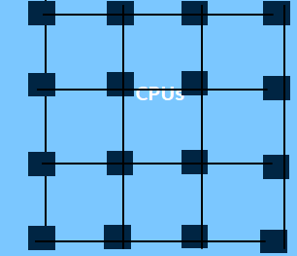


KPI Definition
Latency
create dummy thread in each socket’s
first core to keep CPU active
0.
Initialize memory buffer in target area
1.
buffer
1. Repeat loading data during specific time T
2. count the repeat times N
Create Latency thread on working core :
issued one load of data, get feedback
2.
LLC
Latency = T/N
Only one working core is used in loading data.
The buffer size is used to determine the measuring of L1/L2/L3/DRAM
buffer size vs cache size
buffer size < L1D cache size，hit in L1, get L1 latency.
L1D cache size < buffer size < L2 cache size, hit in L2 , get L2 latency
L2 cache size < buffer size < L3 cache size, hit in L3 , get L3 latency
buffer size > L3 cache size，miss in L3, get memory latency.
.
6

Slide 7
KPI Definition
Bandwidth
Initialize Read
memory buffer
1.
Create bandwidth thread:
issued to load data
from Read buffer
1. Repeat loading data during specific time T
2. count the repeat times N
2.
Read buffer
Load
Write buffer
1.
LLC
Read bandwidth = (Read_buffer_size * N) / T
Get system’s total bandwidth by adding all working cores’ bandwidth together
(Working core list can be configured in the test.)
The buffer size is used to determine the measuring of L1/L2/L3/DRAM.
Support generating different traffic patterns for different R/W ratio.
Store
Read For Ownership + Write
Core Memory Controller DDR
Load
Read
Core Memory Controller DDR
7
Notes:
Read : Write = 3 : 1 from memory controller’s view means Read : Write = 2 : 1 from applications’ point of view. Since store instruction = 1 Read(read ownership) + 1 Write
metric_memory bandwidth read (MB/sec)
146,464.3075
metric_memory bandwidth write (MB/sec)
48,873.9343
(Memory controller view) Read/Write Ratio
3/1

Slide 8
System Configuration
System Info | spr97623 | rasp-1519
BIOS Version | EGSDCRB1.86B.0073.D14.2201260628 | WLYDCRB1.SYS.0027.P56.2112200409
OS | CentOS Stream 8 | Red Hat Enterprise Linux 8.2 (Ootpa)
Kernel | 5.15.0-spr.bkc.pc.2.10.0.x86_64 | 4.18.0-305.19.1.el8_4.x86_64
Microcode | 0x8e0001c0 | 0xd000332
Base Frequency | 1.6GHz | 2.6GHz
Maximum Frequency | 3.5GHz | 3.7GHz
All-core Maximum Frequency | 2.6GHz | 3.3GHz
CPU(s) | 240 | 152
Thread(s) per Core | 2 | 2
Core(s) per Socket | 60 | 38
Socket(s) | 2 | 2
NUMA Node(s) | 2 | 2
NUMA cpulist | 0-59,120-179 :: 60-119,180-239 | 0-37,76-113 :: 38-75,114-151
L1d Cache | 48K | 48K
L1i Cache | 32K | 32K
L2 Cache | 2048K | 1280K
L3 Cache | 115200K | 58368K
Prefetchers | DCU HW, DCU IP, L2 HW, L2 Adj. | DCU HW, DCU IP, L2 HW, L2 Adj.
Intel Turbo Boost | Enabled | Enabled
QPI Link | 4 | 3
Memory Installed | 512GB (16x32GB DDR5 4800MT/s ) | 512GB (16x32GB DDR4 2933MT/s )
Power & Perf Policy | Performance | Performance
Automatic NUMA Balancing | Disabled | Disabled
8

Slide 9
Latency Measurement
ICX/SPR (SNC1)
UPI
NUMA1
Core 0
NUMA0
Core n
Core 0
Core n
L1 Latency
Latency measurement
L1 Latency: ./mlc --idle_latency -e -r -b24K -H
L2 Latency: ./mlc --idle_latency -e -r -b800K -H
L3 Latency (SNC4) : ./mlc --idle_latency -e -r -b6m -H
L3 Latency (SNC1)
Local Memory Latency (SNC4)
Local Memory Latency (SNC1)
Remote Memory Latency (SNC1)
L1 Cache
L1 Cache
L1 Cache
L1 Cache
L2 Latency
L2 Cache
L2 Cache
L2 Cache
L2 Cache
L3 Latency
Remote
Memory Latency
L3 Cache
Local Memory Latency
L3 Cache
socket 0
UPI
socket 1
DRAM
DRAM
SPR(SNC4)
MC0
UPI
MC4
Local Memory Latency (SNC4)
MC2
MC6
L3 Latency (SNC4)
L3 Cache
MC1
SNC0
SNC2
MC5
SNC4
SNC6
MC3
MC7
SNC1
SNC3
SNC5
SNC7
socket 0
UPI
socket 1
9

Slide 10
Latency Data Comparison
Cache Latency | ns (measured) |  | Cycles (calculated by Op-Freq) |  | Cycles (Ref: Fastest Load-to-use)
Cache Latency | ICX1519 | SPR97263 | ICX1519 | SPR97263 | ICX | SPR
L1 | 1.4 | 1.5 | 5.1 | 5.1 | 5 | 5
L2 | 4.9 | 5.4 | 17.8 | 18.4 | 14 | 16
Latency(ns) | ICX1519 | SPR97263 | Ref: ICX Target | Ref: SPR Target
L3(SNC4) | / | 26.0 | / | 22.2
L3(SNC1) | 25.4 | 38.0 | 18.1 | 37.0
Local Memory(SNC4) | / | 91.3 | / | 91.0
Local Memory(SNC1) | 89.7 | 105.2 | 86.5 | 103.0
Remote Memory(SNC1) | 146.0 | 194.6 | 153.8 | 185.0
Platform | Op-Freq | Uncore Freq | Base-Freq | CPU utilization (1t1c)
ICX1519 | 3.656 GHz | 2.200 GHz | 2.6GHz | 47.390%
SPR97263 | 3.403 GHz | 2.501 GHz | 1.6GHz | 47.295%
Ref : 20ww52.2_ICX_DDR_PnP_REPORT.pptx
https://sharepoint.amr.ith.intel.com/sites/server/ goto/SPR Architecture
EGS_Platform_Validation_Integration_Wave2_PnP_Update_WW17.pdf
10
10

Slide 11
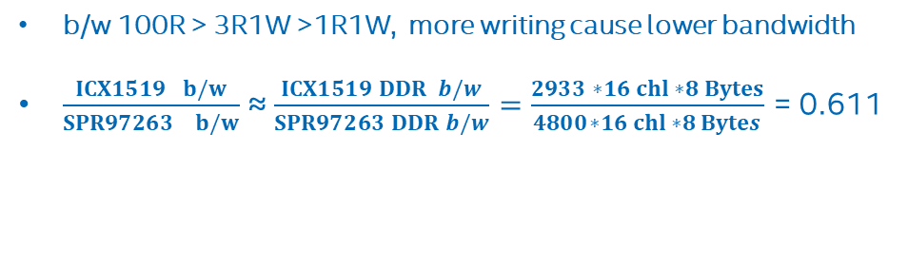
Bandwidth Comparison
Bandwidth measurement -- All cores generate threads to measure bandwidth. Specify read to write ratio for bandwidth thread.
cmd : ./mlc --loaded_latency -d0 -T -X -K1 -W3 (3R1W)
b/w (MB/s) | ICX(2s-76c76t) | HCC 24C | SPR(2s-120c120t) | Target
 | Meas | Ref: HCC 24cTarget | Meas | Ref: Target
100R | 322,145.5 | 348,600.0 | 533,692.2 | 540,910.0
3R1W | 284,495.1 | 289,000.0 | 469,356.3 | 477,450.0
1R1W | 262,793.9 | 249,600.0 | 439,137.4 | 462,640.0
DDR Max | 375,424.0 |  | 614,400.0
b/w 100R > 3R1W >1R1W, more writing cause lower bandwidth
$\frac{ICX1519 b/w}{SPR97263 b/w}$ ≈ $\frac{ICX1519 DDR b/w}{SPR97263 DDR b/w}=\frac{2933 ∗16 chl ∗8 Bytes}{4800∗16 chl ∗8 Bytes}$ = 0.611
Ref : ICX from 20ww52.2_ICX_DDR_PnP_REPORT.pptx
SPR from https://sharepoint.amr.ith.intel.com/sites/server/ goto/SPR Architecture
EGS_Platform_Validation_Integration_Wave2_PnP_Update_WW17.pdf
11
11

Slide 12
Bandwidth Comparison
Hyper-thread ON
cmd : ./mlc --loaded_latency -d0 -T -k0-37,76-113 (0-37,76-113 core works)
ICX(2s) b/w | run1 | run2 | run3 | run4 | run5 | Median | Theo (DDR4 Max b/w) | Median/Theo
0-37 | 163,309.7 | 163,388.8 | 163,292.8 | 161,308.4 | 163,026.5 | 163,292.8 | 187,712.0 | 90.0%
0-37,76-113 | 160,616.4 | 160,603.3 | 160,612.5 | 157,661.5 | 160,275.8 | 160,603.3 | 187,712.0 | 85.6%
0-75 | 325,754.3 | 325,727.0 | 325,418.3 | 325,790.4 | 324,538.2 | 325,727.0 | 375,424.0 | 86.8%
0-151(all cores) | 320,402.0 | 318,991.1 | 317,777.7 | 320,368.5 | 318,732.5 | 318,991.1 | 375,424.0 | 85.0%
SPR(2s) b/w | run1 | run2 | run3 | run4 | run5 | Median | Theo (DDR5 Max b/w) | Median/Theo
0-59 | 269,492.8 | 269,986.0 | 269,814.3 | 270,175.3 | 270,103.4 | 269,492.8 | 307,200.0 | 87.7%
0-59,120-179 | 263,191.6 | 263,246.7 | 262,809.9 | 262,802.2 | 263,147.1 | 263,147.1 | 307,200.0 | 85.6%
0-119 | 538,877.0 | 538,104.8 | 538,675.4 | 538,577.8 | 539,186.1 | 538,675.4 | 614,400.0 | 87.7%
0-239 (all cores) | 527,579.8 | 527,157.7 | 527,538.5 | 527,239.2 | 527,065.3 | 527,239.2 | 614,400.0 | 85.8%
Bandwidth of 2t/c is ~ 98% of bandwidth 1t/c
12
12

Slide 13
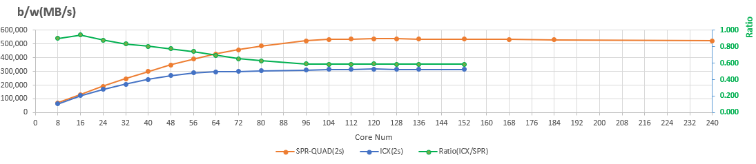
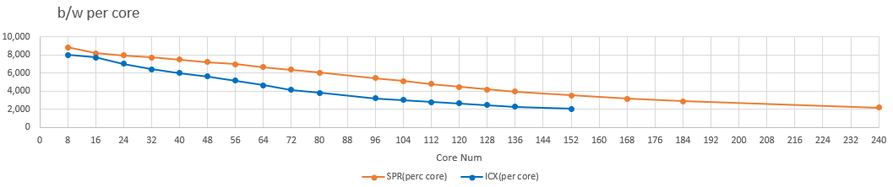
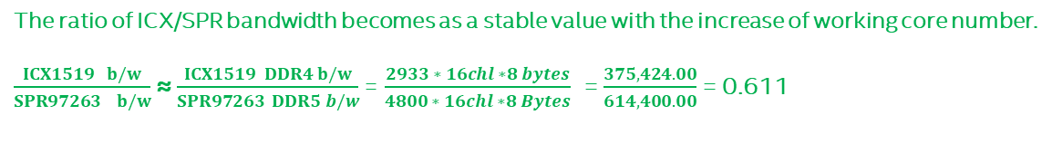
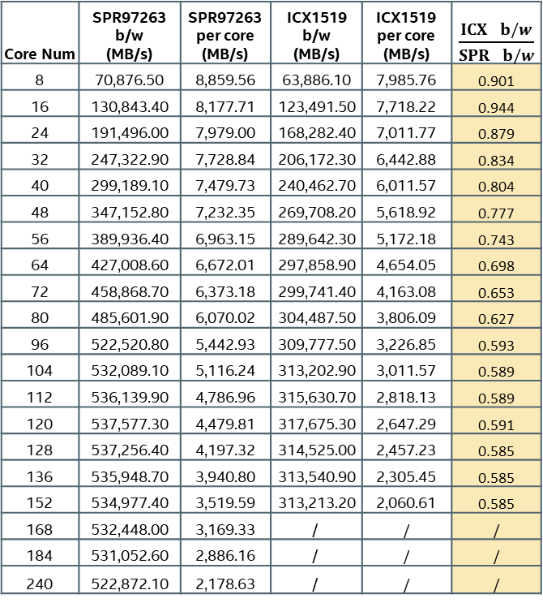
Core Scaling Comparison – ICX(2s) vs SPR(2s)
Hyper-thread ON, cores are selected evenly in sockets and hyperthreading
cmd : ./mlc --loaded_latency -d0 -T -k0-3,60-63,120-123,180-183 (SPR 16core)
Core Num | SPR97263 b/w (MB/s) | SPR97263 per core (MB/s) | ICX1519 b/w (MB/s) | ICX1519 per core (MB/s) | $\frac{ICX b/w}{SPR b/w}$
8 | 70,876.50 | 8,859.56 | 63,886.10 | 7,985.76 | 0.901
16 | 130,843.40 | 8,177.71 | 123,491.50 | 7,718.22 | 0.944
24 | 191,496.00 | 7,979.00 | 168,282.40 | 7,011.77 | 0.879
32 | 247,322.90 | 7,728.84 | 206,172.30 | 6,442.88 | 0.834
40 | 299,189.10 | 7,479.73 | 240,462.70 | 6,011.57 | 0.804
48 | 347,152.80 | 7,232.35 | 269,708.20 | 5,618.92 | 0.777
56 | 389,936.40 | 6,963.15 | 289,642.30 | 5,172.18 | 0.743
64 | 427,008.60 | 6,672.01 | 297,858.90 | 4,654.05 | 0.698
72 | 458,868.70 | 6,373.18 | 299,741.40 | 4,163.08 | 0.653
80 | 485,601.90 | 6,070.02 | 304,487.50 | 3,806.09 | 0.627
96 | 522,520.80 | 5,442.93 | 309,777.50 | 3,226.85 | 0.593
104 | 532,089.10 | 5,116.24 | 313,202.90 | 3,011.57 | 0.589
112 | 536,139.90 | 4,786.96 | 315,630.70 | 2,818.13 | 0.589
120 | 537,577.30 | 4,479.81 | 317,675.30 | 2,647.29 | 0.591
128 | 537,256.40 | 4,197.32 | 314,525.00 | 2,457.23 | 0.585
136 | 535,948.70 | 3,940.80 | 313,540.90 | 2,305.45 | 0.585
152 | 534,977.40 | 3,519.59 | 313,213.20 | 2,060.61 | 0.585
168 | 532,448.00 | 3,169.33 | / | / | /
184 | 531,052.60 | 2,886.16 | / | / | /
240 | 522,872.10 | 2,178.63 | / | / | /
The ratio of ICX/SPR bandwidth becomes as a stable value with the increase of working core number.
$\frac{ICX1519 b/w}{SPR97263 b/w}$ ≈ $\frac{ICX1519 DDR4 b/w}{SPR97263 DDR5 b/w}$= $\frac{2933 ∗ 16chl ∗8 bytes}{4800 ∗ 16chl ∗8 Bytes}$ = $\frac{375,424.00}{614,400.00}$= 0.611
13
13

Slide 14
SPR Core Scaling Comparison – QUAD(2s) vs SNC4(2s)
Hyper-thread ON, cores are selected evenly in sockets and hyperthreading
cmd : ./mlc --loaded_latency -d0 -T -k0-1,15-16,30-31,45-46,60-61,75-76,90-91,105-106 (SPR 16core)
Core Num | QUAD b/w (MB/s) | SNC4 b/w (MB/s) | SNC4/QUAD
8 | 129,348.50 | 143,793.50 | 1.112
16 | 238,191.60 | 257,890.60 | 1.083
24 | 322,038.50 | 329,572.20 | 1.023
32 | 333,227.40 | 331,421.70 | 0.995
40 | 427,445.20 | 431,177.50 | 1.009
48 | 485,959.60 | 510,517.10 | 1.051
56 | 539,536.60 | 551,555.10 | 1.022
64 | 546,923.60 | 555,987.70 | 1.017
72 | 545,551.10 | 554,561.10 | 1.017
80 | 544,026.00 | 552,365.40 | 1.015
96 | 542,060.20 | 548,847.40 | 1.013
104 | 541,129.20 | 548,537.40 | 1.014
112 | 539,505.60 | 547,208.50 | 1.014
120 | 535,711.70 | 546,422.30 | 1.020
128 | 535,293.50 | 546,750.10 | 1.021
136 | 534,460.10 | 545,798.60 | 1.021
152 | 533,922.80 | 543,537.20 | 1.018
168 | 531,934.00 | 541,669.30 | 1.018
184 | 531,250.50 | 541,388.50 | 1.019
240 | 510,185.60 | 537,428.30 | 1.053
DDR5 b/w (MB/s) | 614,400.00
SNC4 performance is a little better than QUAD.
14
14

Slide 15
Conclusion & Next Step
Conclusion.
Same bandwidth test case on ICX and SPR, SPR performance is better than ICX.
Both on ICX and SPR, with the increase of CPU core number, the performance would also increase at the beginning. Then it becomes stable.
The ratio of ICX/SPR bandwidth is asymptotic the value of DDR speed ratio .
With the same working cores, the SNC4 performance is a little better than QUAD.
Next Step:
Try MLC’s more paraments for more features
Try to help tuning other WL performance with MLC test case
15

Slide 16
Thank You
16

